Slide 1
INVESTMENT CASE STUDY SUBMISSION
Name:
Goutam Dutta

Slide 2
Spark Fund’s best destination of investment analysis
Business Objective
Identify the best sectors, best countries to invest and the type of investment for making the final decision to invest.
Invested amount is between 5 to 15 million USD per round of investment.
Target of investment is in English-speaking countries only for the ease of communication.
Invest in best sectors and countries where most of the investors are investing.
Business Goals
Find the type of investment based on the invested amount from other investors.
Find the English speaking countries where the investments were made in the past.
Find the suitable sectors to invest based on the below eight main sectors as given below
Automotive & Sports
Clean tech / Semiconductors
Entertainment
Health
Manufacturing
News, Search and Messaging
Social, Finance, Analytics, Advertising
Others

Slide 3
CRISP-DM Framework

Slide 4
Load, Clean and Analysis : Company
Source
Load the companies data from companies.txt.
Raw Data
The companies data includes countries which are not English speaking. The company link column does not match with funding round table data. There are some columns which does not have values in it. Also this table contains data which are not formatted with upper case or lower case.
Processing of Raw Data (Cleaning & Reshaping)
The unique key for the company is “permalink”.
The column name has been modified from “permalink” to “country_permalink” to create relationship with the rounds2 table.
All records are reshaped in lower case in company data frame.
Company data frame is merged to the funding rounds data frame in order to get full funding information.
Data Analysis
66370 companies are present in funding rounds table out of 66368 original unique companies.

Slide 5
Load, Clean and Analysis : Funding Types
Source
Load the funding types from the rounds2.csv
Raw Data
The main records for this data frame are country_permalink, name, category list, country_code, funding_round_type, raised_amount_usd. The data is not formatted with lowercase.
Processing of Raw Data (Cleaning & Reshaping)
All records are formatted with lower case for the ease of analysis.
These records are merged with the company records to get a full set of information about the investment.
The main sector are now linked with the funding type, amount invested with the company records
Irrelevant columns are removed and checked if any data with empty rows. Rows missing more than 3 values are removed.
The range of data is filtered with English speaking countries and invested amount between 5 million and 15 million.
The primary sector is fetched from the category list in a separate column for further analysis.
Data Analysis
The master data frame contains 114942 records.
The average invested amount for venture, angel , seed and private equity are $11738739, $968283, $748081 and $73604178 respectively.
The maximum amount invested for venture, angel, seed and private equity are $ 564363369185, $ 4284652356, $ 15874282311 and $ 134990064238 respectively.
Most companies have invested in venture type of funding.

Slide 6
Load, Clean and Analysis : Country wise Funding
Source
The English speaking countries are provided continent wise in the form of PDF. The master frame records contains merged data from sector details and countries code. This is the main source for the analysis of country wise funding.
Raw Data
The master frame records and country list are used as the raw data for the analysis.
Processing of Raw Data (Cleaning & Reshaping)
The master frame records are grouped by funding type, country wise and the data was formed by removing all null funding amounts.
The resulted data is filtered with the English speaking countries to fetch the top 9 countries as required by the business.
Venture type of funding has been chosen for further analysis as it has been observed that most the companies have invested in this type of investment.
Top three countries data frame has been created for further analysis to find the sector wise investments in each country.
Data Analysis
Venture type of funding from USA has the highest funding : $ 392 billion , followed by UK at $ 18 billion and India at $ 13 billion.
Top sector which got most funding i.e. 2400 is Others.
SpiderCloud Wireless from USA, Myoptique Group from UK and Eximsoft-Trianz from India have done highest investment from their respective countries.

Slide 7
Load, Clean and Analysis : Sector Analysis
Source
Load data from the mapping.csv to analyze the sectors
Raw Data
The records contains category and main sectors which is used for the analysis. There are some null value rows and sectors are not mapped with the category
Processing of Raw Data (Cleaning & Reshaping)
The records are grouped by finding out the primary categories with the main sectors and by removing the null value row.
The resulted data is primary sector with the main sector
The data is merged with the master data to relate the primary sectors with the main sector.
Data Analysis
There are 8 main sector and primary sectors from the master data is merged.
Main sector is now merged with the funding type and category to find out the most suitable main sector for the funding type

Slide 8
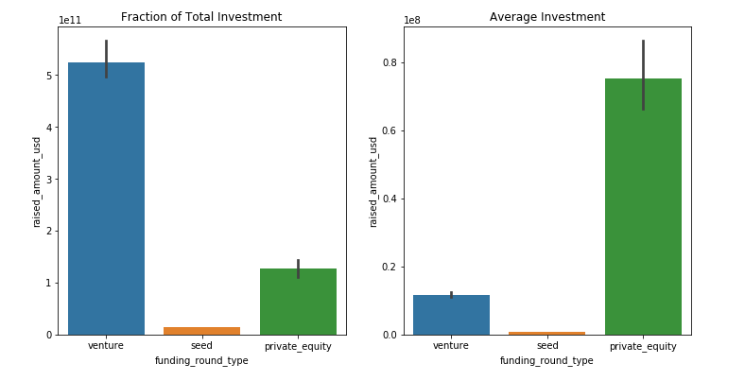
Results I: Investing trends for top investment types

Slide 9
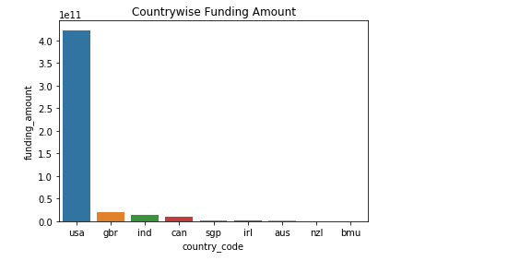
Results II : Investing trends in top 9 countries

Slide 10
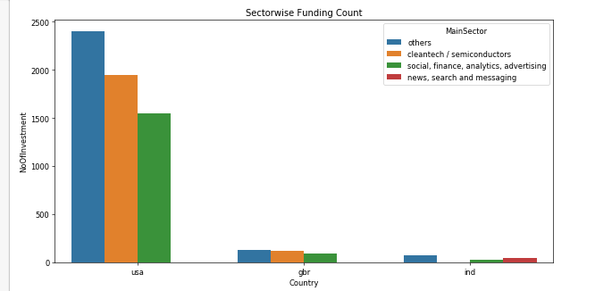
Results III: Investing trends sector wise for top countries

Slide 11
Conclusions
Maximum investments are in USA and the main sector of investment is Others and company spidercloud wireless.
The second most investments are in Great Britain and the main sector of investment is Others and company myoptique group.
The third most investments are in India and the main sector of investment is Others and company eximsoft-trianz
USA is also a major contributor for investing in venture type fund.
Global trend in investment is in private equity fund.
Based on the data and the analysis of the outcome it is found that Venture type funding is most suited for English speaking countries in others sector.

